Slide 1

Major Project -II(CA401P) Even Semester Session 2025-26 “MuseCrafts” Ayush Saini (202410116100046) Ashish Yadav (202410116100041) Anubhav Vaish(202410116100037) Session:2025-2026 (IV Semester) Under the supervision of Mr. Roshan Kumar Gupta, Mrs. Anita Yadav Department Of Computer Applications KIET GROUP OF INSTITUTIONS, DELHI-NCR, GHAZIABAD-201206

Slide 2

MuseCraft
A Creative Digital Platform

Slide 3
Project Overview
Web-Based Platform
Comprehensive Toolset
A fully accessible creative environment that runs directly in browsers, eliminating the need for software installations
Integrated design, editing, and publishing capabilities that streamline the entire creative workflow
Collaborative Environment
Centralized Management
Real-time collaboration features that enable designers, creators, and students to work together seamlessly
Unified system for organizing and managing multiple creative projects from a single dashboard
MuseCraft represents a comprehensive digital solution designed to address the fragmented nature of modern creative workflows. By consolidating essential design tools, collaboration features, and project management capabilities into a single platform, MuseCraft empowers users to focus on their creative vision rather than navigating between multiple applications.

Slide 4
Problem Definition
Fragmented Tool Ecosystem
Absence of Centralized Management
Creative professionals must juggle multiple specialized applications for different design tasks, leading to workflow interruptions, context switching, and lost productivity. Each tool requires separate learning curves and file format conversions.
Without a unified system to track project progress, assets, and versions, teams struggle with organization. Critical files get scattered across drives and cloud services, making it difficult to locate specific assets or maintain version control.
Collaboration Barriers
Disconnected Creation & Sharing
Current solutions make real-time teamwork challenging. Designers must constantly export files, send them via email or messaging apps, and wait for feedback. This asynchronous process extends project timelines and creates confusion about which version is current.
The gap between creating content and sharing it with stakeholders or audiences requires additional steps and platforms. This disconnect prevents immediate feedback and slows down iteration cycles, hindering creative momentum.

Slide 5
Proposed Solution
Unified Platform
Cloud-Based Infrastructure
MuseCraft consolidates all essential creative tools into a single, intuitive interface. Users access design, editing, and publishing features without switching applications or managing multiple accounts. This integration eliminates workflow friction and reduces the learning curve associated with mastering disparate tools.
All project assets store securely in the cloud, accessible from any device with internet connectivity. Automatic version tracking ensures users never lose work or confusion about which file represents the latest iteration. Storage scales with project needs without local disk space constraints.
Real-Time Collaboration
Integrated Design Suite
Team members work simultaneously on shared projects, seeing each other's changes instantly. Built-in commenting, task assignment, and approval workflows streamline communication. Stakeholders provide feedback directly on designs rather than describing changes in separate messages.
The platform provides comprehensive tools for every stage of content creation. From initial concept sketching to detailed design work, from photo editing to video production, all capabilities reside within MuseCraft's ecosystem. Users work with familiar, industry-standard features adapted to web-based operation.

Slide 6



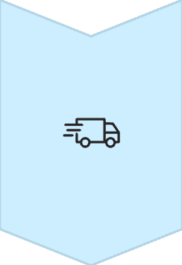

Project Objectives
These strategic goals guide MuseCraft's development and ensure the platform delivers measurable value to creative professionals and students alike.
User-Friendly Design
Develop an intuitive, accessible interface that requires minimal training while supporting advanced creative workflows
Real-Time Collaboration
Enable seamless teamwork with instant synchronization, live editing, and integrated communication tools
Accelerated Creation
Reduce content production time through integrated tools, automated processes, and streamlined workflows
Secure Management
Implement robust data protection, access controls, and backup systems to safeguard creative work

Slide 7

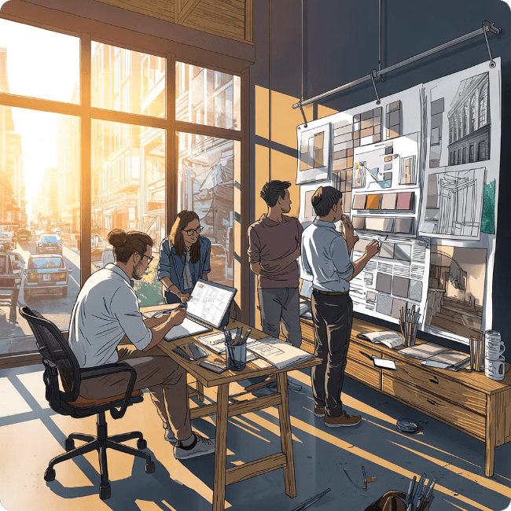
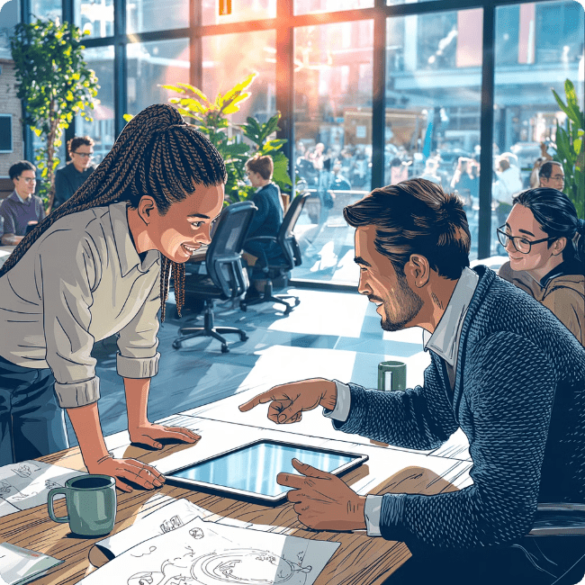

Scope of the Project
Web-Based Application
Individual & Team Projects
Target User Base
Current implementation as a responsive web application accessible from any device with a modern browser. Future expansion includes native mobile applications for iOS and Android platforms, extending creative capabilities to mobile workflows.
Supports both solo creative work and collaborative team environments. Users can switch between private projects and shared workspaces, managing permissions and access levels for team-based initiatives of any scale.
Caters to students learning design skills, freelancers managing multiple client projects, and professional designers in agencies or corporate environments. Each user segment benefits from tailored features while sharing core functionality.
Future Enhancements
The platform architecture accommodates future integrations including AI-powered design suggestions that analyze trends and user preferences, automated layout generation from content, and direct publishing to major social media platforms for immediate audience reach.

Slide 8
Methodology
A systematic, phased approach ensures MuseCraft meets technical requirements while remaining aligned with user needs throughout development.
Requirement Gathering
Comprehensive analysis of user needs through surveys, interviews with target users, competitive platform research, and identification of essential features. Documentation includes functional and non-functional requirements.
System Design
Creation of detailed architectural blueprints using UML class diagrams, sequence diagrams, and activity diagrams. Data flow diagrams map information movement. Interface mockups establish user experience standards.
Development Phase
Iterative implementation of frontend interfaces using responsive frameworks and backend services with secure API endpoints. Database schema construction follows normalization principles. Version control manages codebase.
Testing Procedures
Unit testing validates individual components. Integration testing ensures modules work together. System testing verifies complete functionality. User acceptance testing confirms platform meets real-world requirements.
Deployment
Production environment setup with server configuration, domain registration, SSL certificate installation, and initial content population. Monitoring systems track performance and error conditions.

Slide 9

Tools & Technologies
Frontend Stack
Development Environment
HTML5: Semantic markup for accessible, SEO-friendly structure
CSS3: Styling with responsive design principles and animations
JavaScript: Interactive functionality with ES6+ features and DOM manipulation
VS Code: Primary code editor with extensions for syntax highlighting and debugging
Git: Version control for collaborative development and change tracking
Backend Infrastructure
Design Documentation
Java/Node.js: Server-side logic with robust frameworks for handling requests and business operations
MySQL: Relational database for structured data storage with ACID compliance
UML Diagrams: Class, sequence, and component diagrams for system architecture
DFD: Data flow diagrams illustrating information movement between system components

Slide 10
Expected Outcomes
Streamlined Content Creation
Enhanced Team Collaboration
Users complete design tasks 30-40% faster by eliminating application switching and file format conversions. Integrated tools reduce repetitive manual operations.
Real-time editing and commenting reduces project completion time by 25%. Teams achieve alignment faster with shared context and immediate feedback loops.
Reduced Manual Effort
Improved Project Organization
Automated version control, asset organization, and workflow management eliminates 15-20 hours of administrative work per project cycle.
Centralized dashboard provides clear visibility into all active projects, deadlines, and team responsibilities. Search and filtering locate specific assets instantly.
MuseCraft delivers measurable improvements across key performance metrics that matter to creative professionals. By consolidating tools, enabling collaboration, and automating administrative tasks, the platform transforms how teams approach creative work. Users report higher satisfaction, faster delivery times, and reduced frustration with technical obstacles.

Slide 11
Conclusion
Comprehensive Creative Solution
Real-World Problem Solver
Scalable Architecture
MuseCraft integrates all essential design tools, collaboration features, and project management capabilities into a single, cohesive platform
Addresses genuine pain points in creative workflows: fragmented tools, collaboration barriers, and organizational chaos
Modular design accommodates growing user bases, expanding feature sets, and future technology integrations including AI and mobile platforms
"MuseCraft represents a complete creative solution that solves real-world design workflow problems with a scalable and future-ready system."
The platform successfully bridges the gap between powerful creative tools and accessible, collaborative workflows. By focusing on user needs, implementing robust technical architecture, and planning for future expansion, MuseCraft positions itself as a valuable resource for students, freelancers, and professional designers seeking efficiency and quality in their creative work.

